Slide 1
Emerging Issues

Slide 2
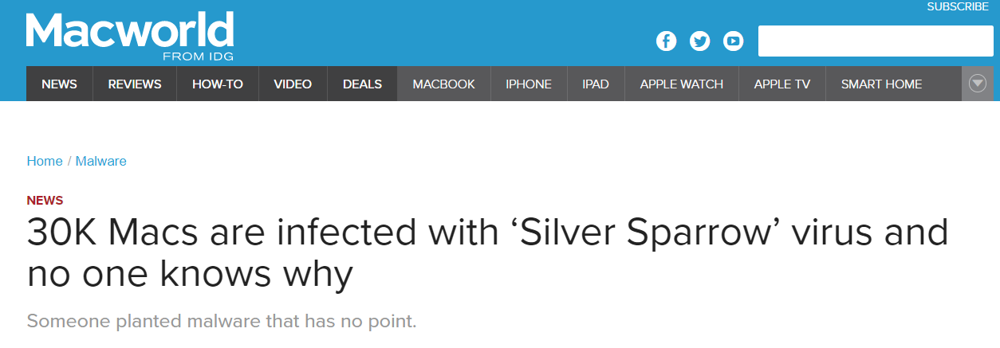
Mars -- https://youtu.be/4czjS9h4Fpg
https://aurora.tech/blog/scaling-simulation
https://www.macworld.com/article/3608621/30k-macs-are-infected-with-silver-sparrow-virus-and-no-one-knows-why.html

Slide 3
Emerging issues
Do some research on tech issues (coding, AI, VR, AR)
Also tech news
Self driving cars
AI helping with corona virus
Issues that have happened
PowerPoint that you will present to the class

Slide 4
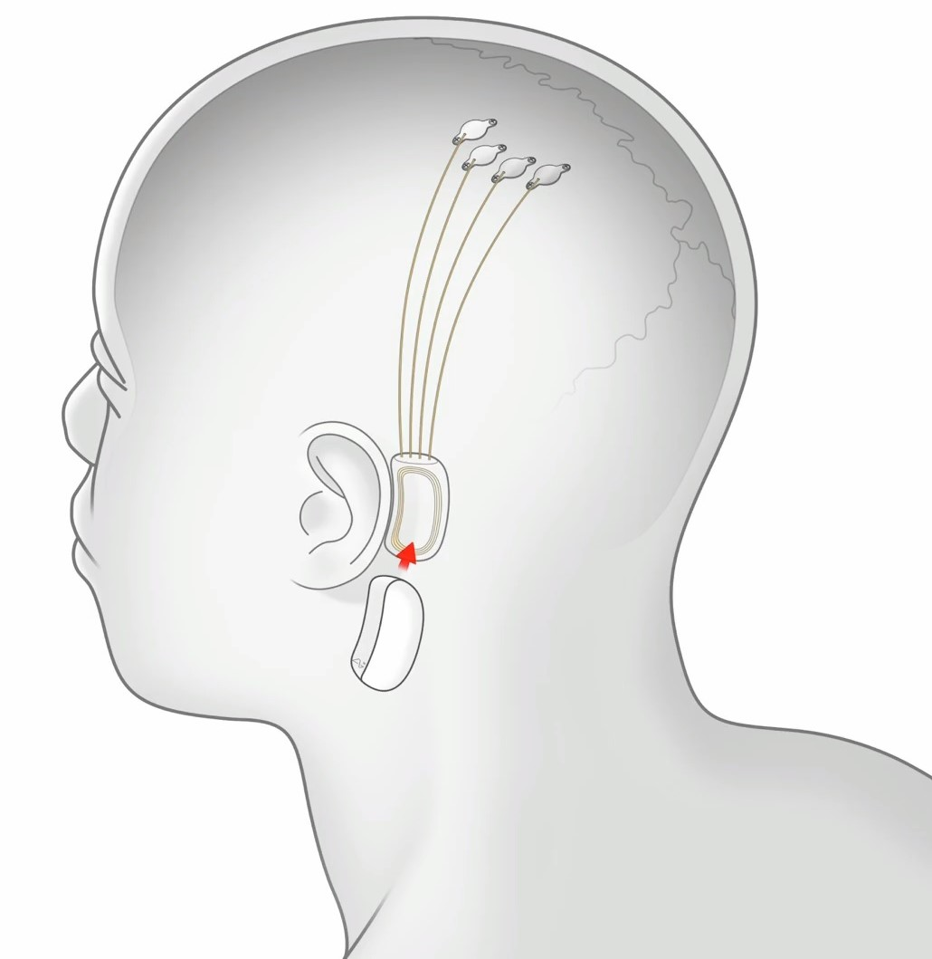
EMERGING ISSUES Other random links I find during the year
https://news.ycombinator.com/item?id=30053761
Get Ready Player One / Facebook Meta
AR
Internet of things
Blockchain - Bitcoin / NFT
Digital haircuts
Edge AI
Batteries
Face recognition / Apple AirTags
NeuraLink
Raw Materials
SPACE!! Mining.
Robots / Cars / IOT
Factory Meat.

Slide 5
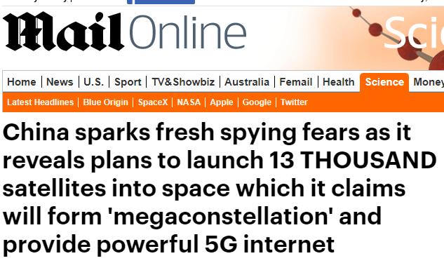
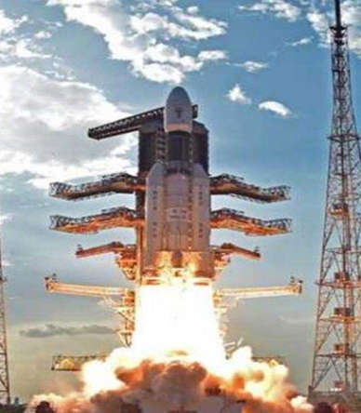

Slide 6
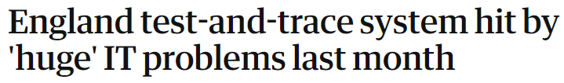






Ideas on where to find stories
Tech crunch
BBC Technology & Science
Reddit
CNET
YouTube
Wired

